Slide 1



Moral Judgements Online Learning Noceboes for Infectious Risk (MJOLNIR)
Date: 6/15/2022
Notes:
So I wanted to talk to everyone about our new study, MJOLNIR, which stands for Moral Judgements Online: Learning under Nocebo and Infectious Risk

Slide 2

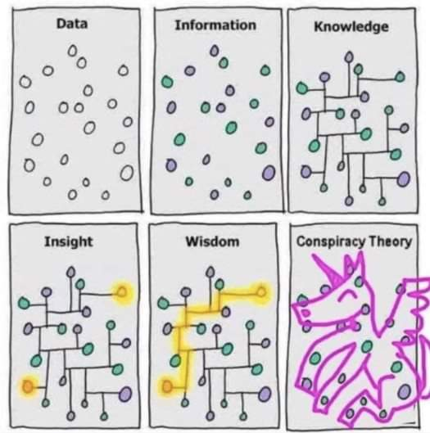

•Collective crises heightens sensitivity to social interactions
•Moral responsibility can be a powerful motivator
•Continued exposure and chronic anxiety can worsen outcomes
•How we behave determines how we will cope
Motivation
Notes:
Harder than ever with a polarized public.
Attach judgments by copying and pasting other judgments.
2

Slide 3
Pandemics require coordinated social action to abate.
Judgments tune action.
Harmful judgments by individuals can
perpetuate false beliefs
threaten public health and
sow social discord.
Judgments express belief.
Motivation
Notes:
Harder than ever with a polarized public.
Attach judgments by copying and pasting other judgments.
3

Slide 4

Notes:
Harder than ever with a polarized public.
Attach judgments by copying and pasting other judgments.
4

Slide 5
How do people integrate information such that…
•lower-order expectancies regarding infectious risk and its
transmission are impacted?
•higher-order beliefs about morality are impacted?
Are these expectancies and beliefs malleable
by updating them with higher-order moral
communication?
…if so, who are the people most susceptible
or resistant to it?
Motivation
Notes:
Harder than ever with a polarized public.
Attach judgments by copying and pasting other judgments.
5

Slide 6
To understand
the structure of COVID-19-based beliefs (e.g., misconceptions).
how they relate to more (personality) and less (psychopathology)
stable beliefs about the self, relative to other traits.
dynamic social-cognitive interactions that underlie disease-related moral
judgments that serve to express beliefs regarding
the self and COVID-19.
To develop trait-based signatures
underlying COVID-19 beliefs
that may predict social discord.
Motivation
Notes:
Harder than ever with a polarized public.
Attach judgments by copying and pasting other judgments.
6

Slide 7
H1a. Can observed situational cues such as the hoarding of certain objects or the perceived race of a person produce a "devil effect", negatively influencing moral judgments and subsequently “spilling over” into the socially-divisive judgments about other people's potential to contract and transmit COVID-19?
H1b. Are morality judgments about the self stable (i.e., invariant across situations) by contrast?
H2a. Do reported patterns of judgments reflect something akin to a fundamental attribution error, whereby individuals rate themselves as more moral (self-targeted moral-favoritism) and others as less moral (other-targeted moral-denigration), and therefore less prone to contracting and transmitting COVID-19 than others?
H2b. Is self-targeted moral-favoritism or other-targeted moral-denigration more responsible for increases in judgments about other people's potential to contract and transmit COVID-19?
H2c. Does self-targeted moral-favoritism drive other-targeted moral-denigration?
H3a. Does people reduce their attributions of COVID-19 contraction and transmission probability after learning prosocial information about a person by mitigating other-targeted moral denigration?
H3b. Does self-targeted moral-favoritism maintain other-targeted moral-denigration and reduce learning effects due to prosocial information?
H4. In the context of COVID-19, are there differences in cue-based situational judgments about others and the self between Chinese and Whites, especially when the target is perceived to be Chinese compared to if they are perceived to be White, Black/African American, or Indian/Sri-Lankan?
Hypotheses

Slide 8

Data Collection: 06/04/2020-08/31/2020
Demographics
COVID-19 Screener
COVID Skepticism
OSF Registries | Moral Judgments Online: A COVID-19 Study
Notes:
Assumptions
If we assume these, we can make inferences about other parts of the model
1. Desires are stable (preferences)
2. Actions: Action is undesirable
3. Beliefs about state of world are updated by actions
4. World has a certain way of being perceived (e.g., Line of sight)
Alternatively, behavior may be inconsistent with some of these, perhaps challenging these assumptions. e.g. there may be behavior inconsistent with any plausible set of beliefs given the assumptions — “wandering” in the food truck example
Inference allows for alternative explanations, guided by priors
e.g., Pr(B, D, P, S|A)
Is a complex inference given impoverished information.
Hierarchical Bayesian belief network
Top-Down: Abstract -> Concrete Tiers
Abstract beliefs serve as generative models for more concrete ones
Worldview -> theories -> claims -> intentions
Consider the outcome of interest (Judgments)
Bottom-Up: Structure Learning
Bayesian-directed Hill-Climbing (BDHC)
Plot the log-likelihood loss and number of edges as performance indicators comparing competitive algorithms (eg., HC, MMHC) predicting out of sample data across 10 run 10-fold cross-validation
Use the adjacency matrix to produce a Gaussian linear directed acyclic graph (DAG) to represent a belief network.

Slide 9
AMBI
AMBI
AMBI
AMBI
Demographics
COVID-19 Screener
COVID Misconceptions
Vignette 1
Vignette 2
Vignette 3
Vignette 4
Update 1
Update 2
Update 3
Update 4
ReCaptcha
Overt
Checks
Discreet
Check
Discreet
Check
Discreet
Check
Discreet
Check
Method
Notes:
Analog to Multiple Broadband Inventories
Big5

Slide 10
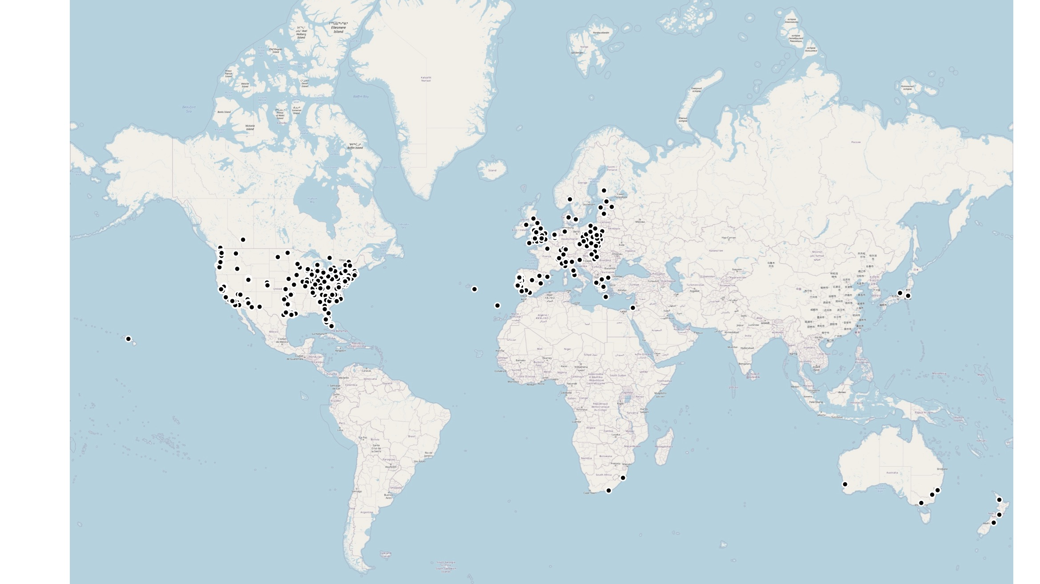
Demographics

Slide 11
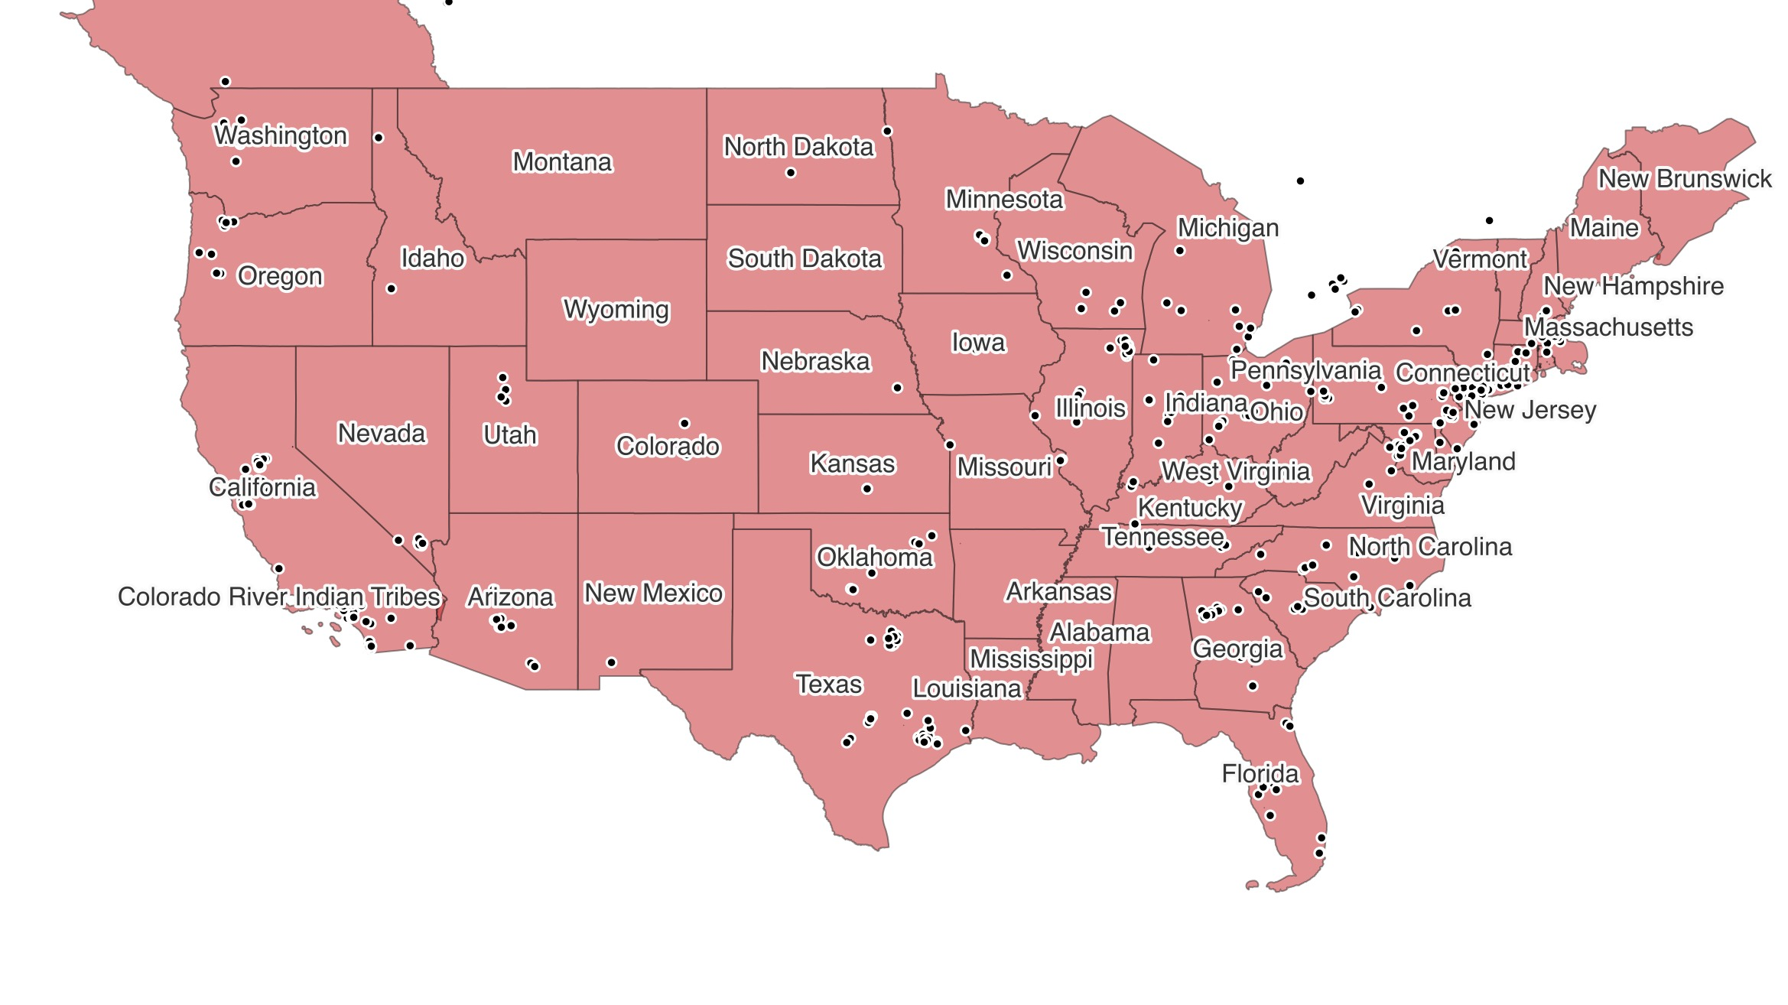
Demographics

Slide 12
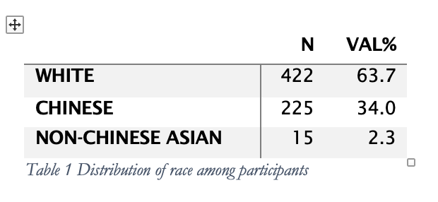
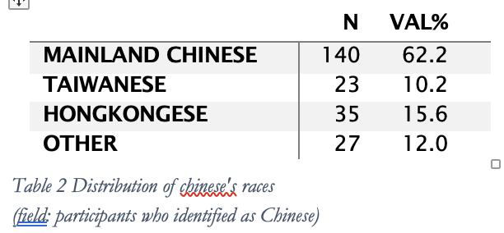
Demographics
Race And Ethnicity

Slide 13
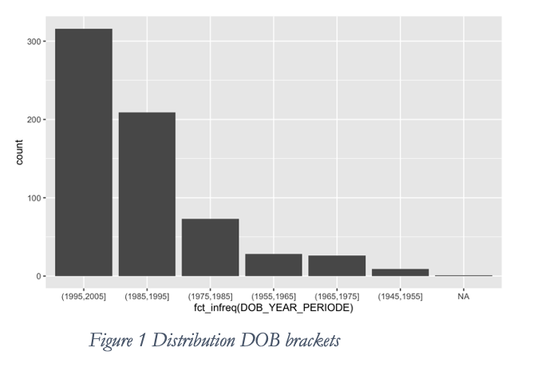
Demographics
Age and DOB - a young sample

Slide 14
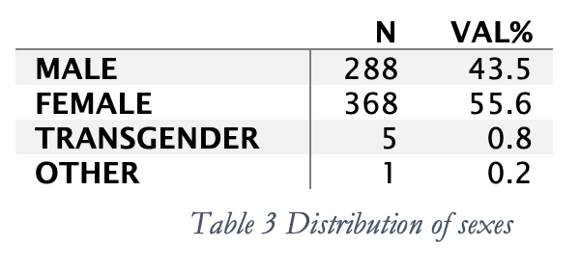
Demographics
Sexe – overrepresentation of Female

Slide 15
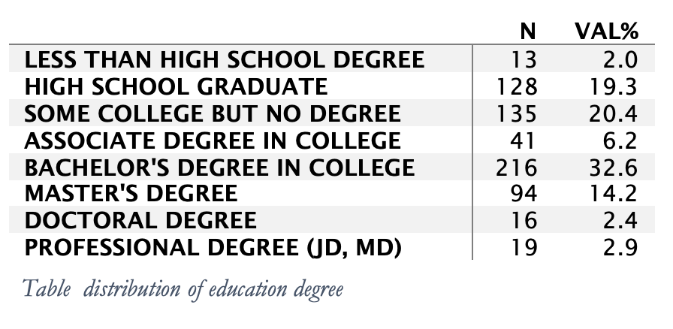
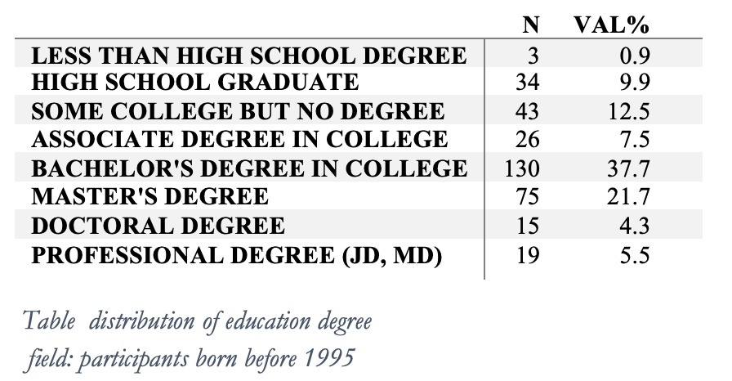
Demographics
Education – college students and college graduates

Slide 16
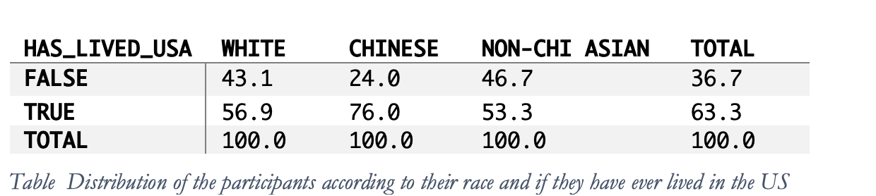
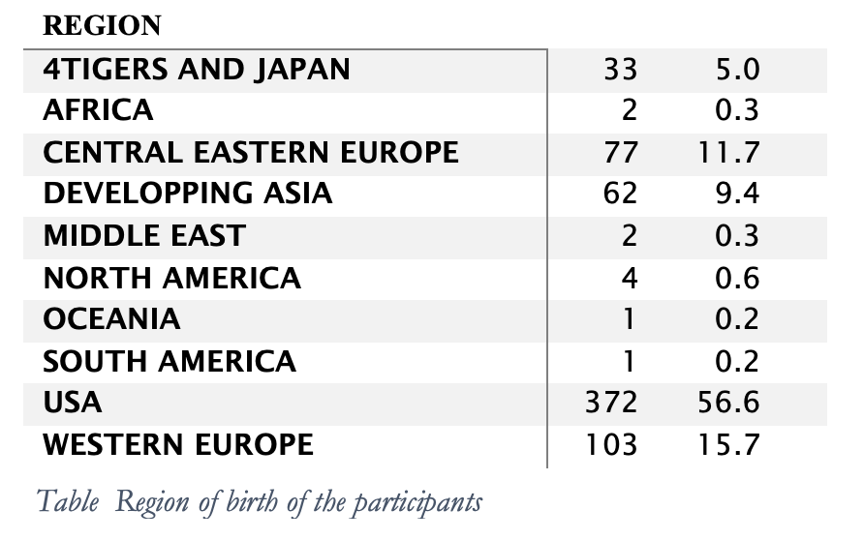
Demographics
Country of birth – small majority of Americans

Slide 17
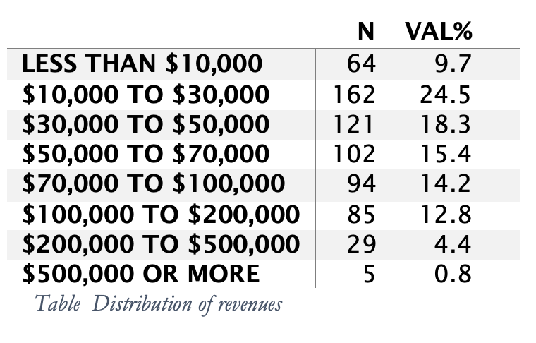
Demographics
Revenue – very disparate incomes

Slide 18
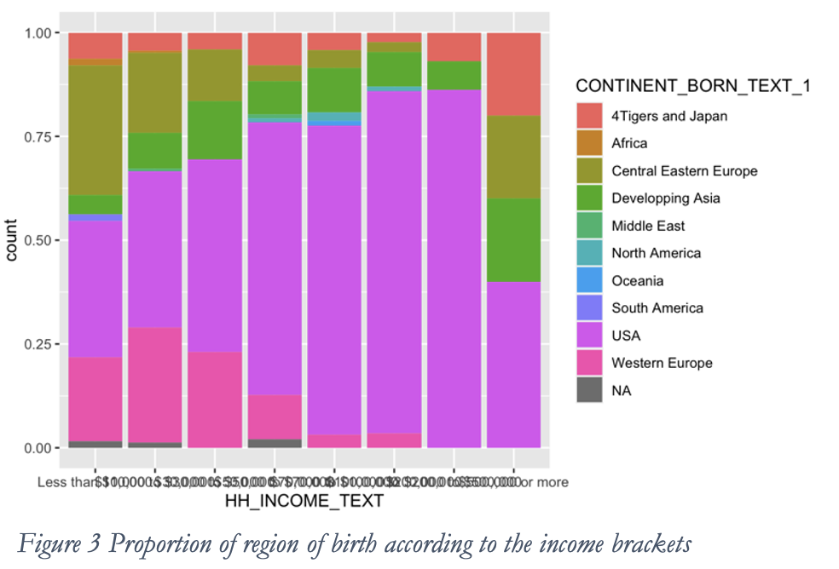
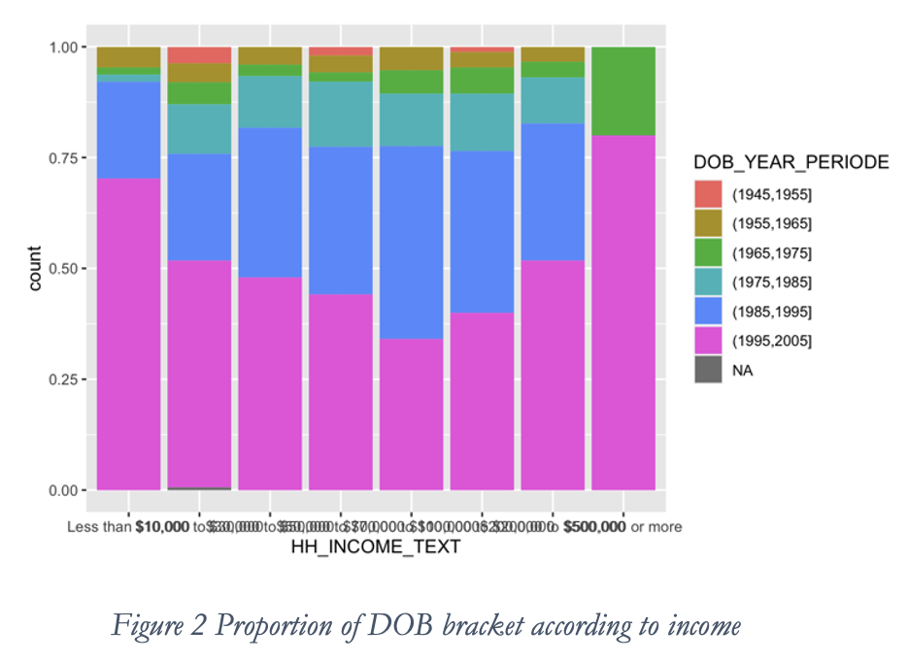
Demographics
Income country of birth and Age

Slide 19
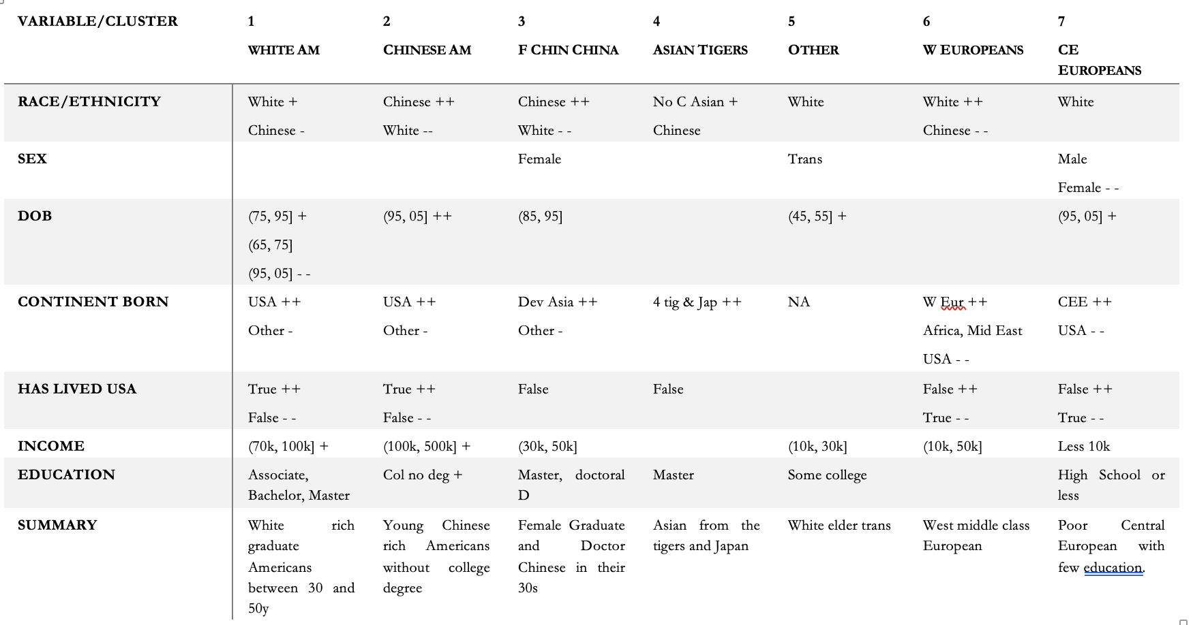
Demographics
7 clusters

Slide 20
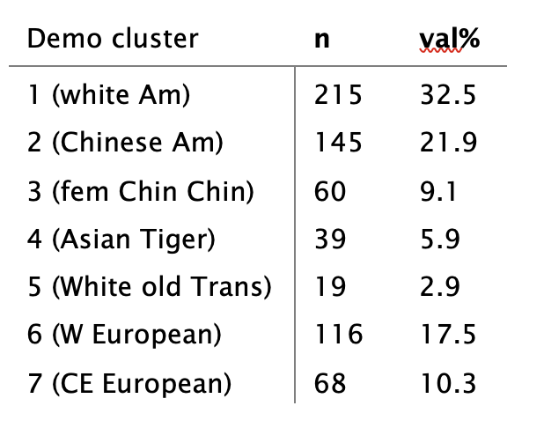
Demographics
Frequency of cluster

Slide 21
Demographics
To do:
City/rural
Location (Continent/region)

Slide 22
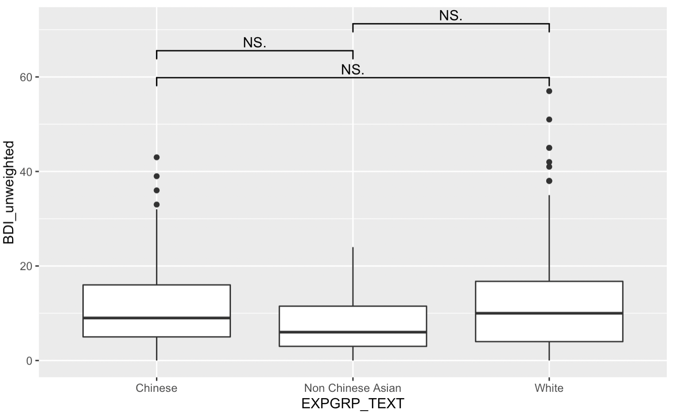
Beck Depression Inventory (BDI)
BDI vs Ethnicity

Slide 23
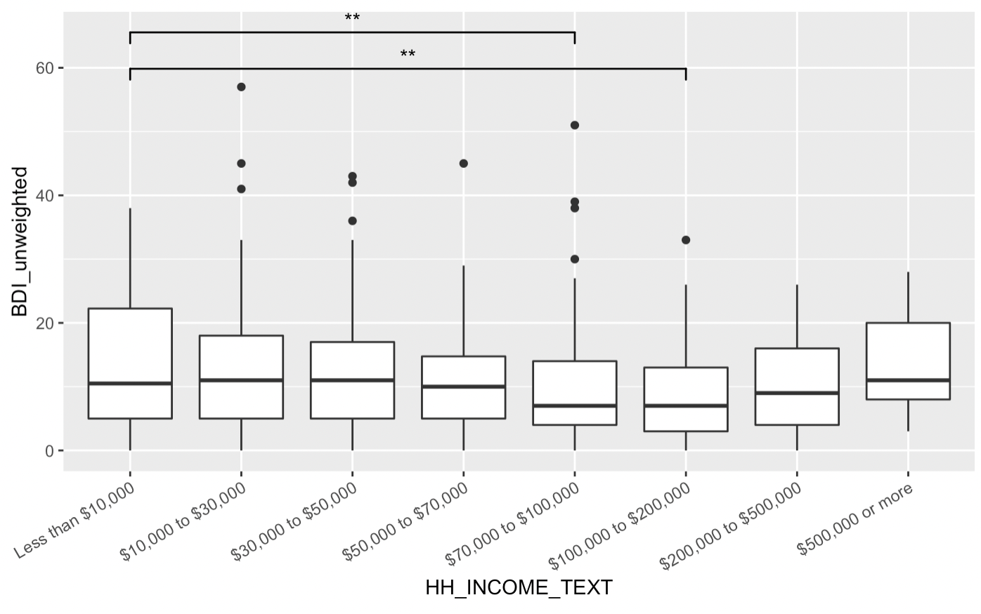
Beck Depression Inventory (BDI)
BDI vs Income

Slide 24
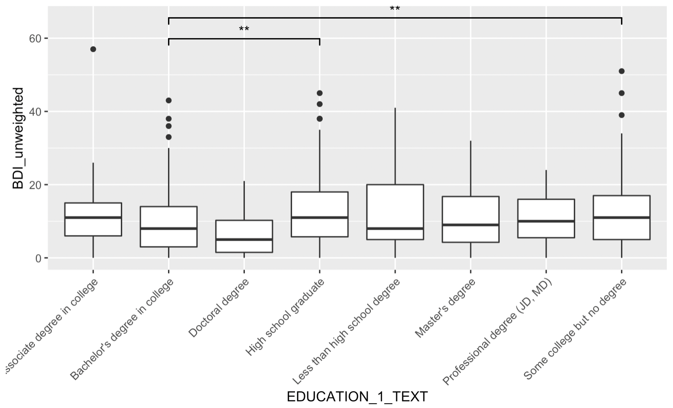
Beck Depression Inventory (BDI)
BDI vs Education

Slide 25
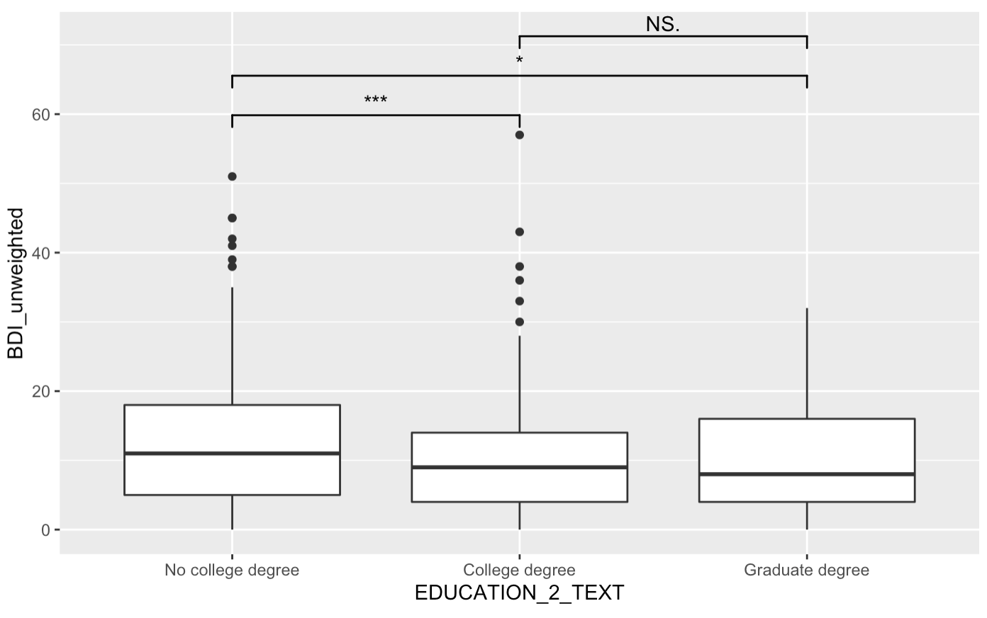
Beck Depression Inventory (BDI)
BDI vs Education

Slide 26
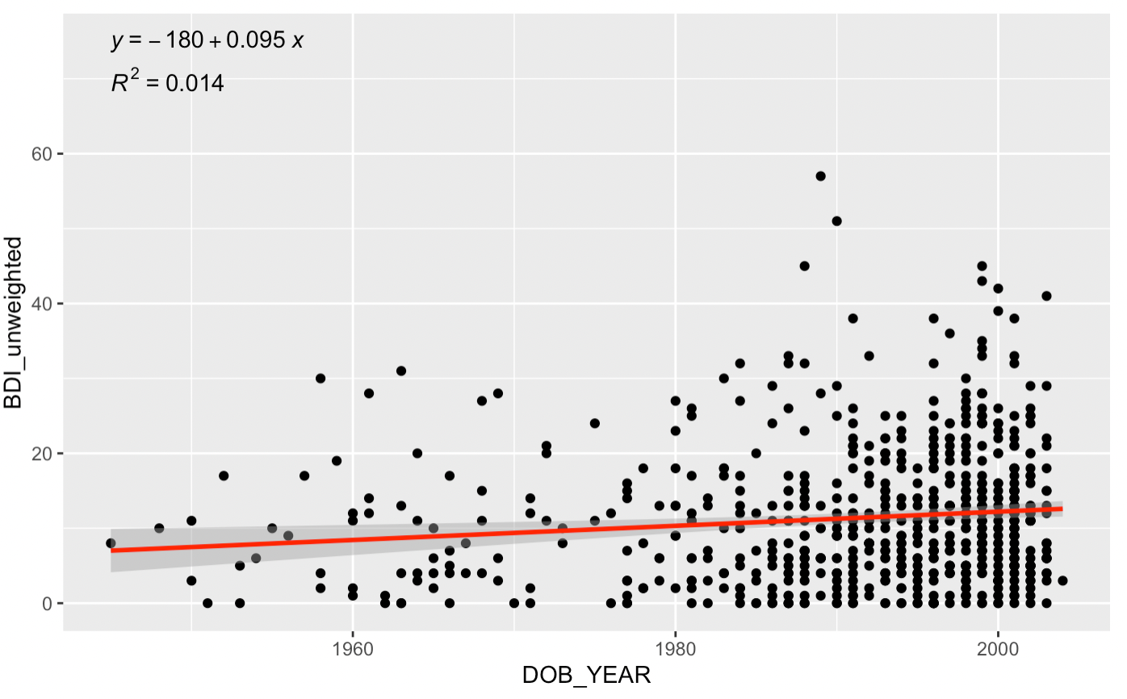
Beck Depression Inventory (BDI)
BDI vs Age
p < 0.01

Slide 27
Personality-level Individual Differences AMBI
Standardizartion 0-1 of 200 personality scale

Slide 28
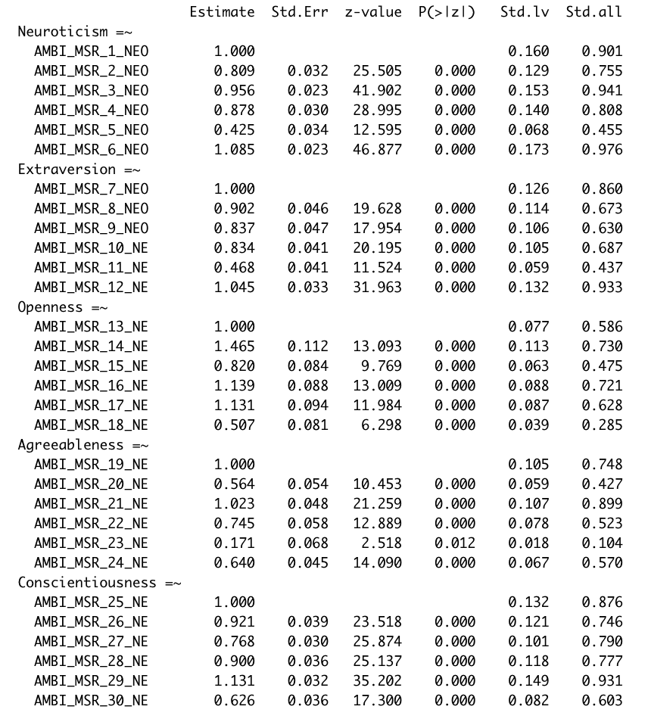
Personality-level Individual Differences – The Big 5

Slide 29
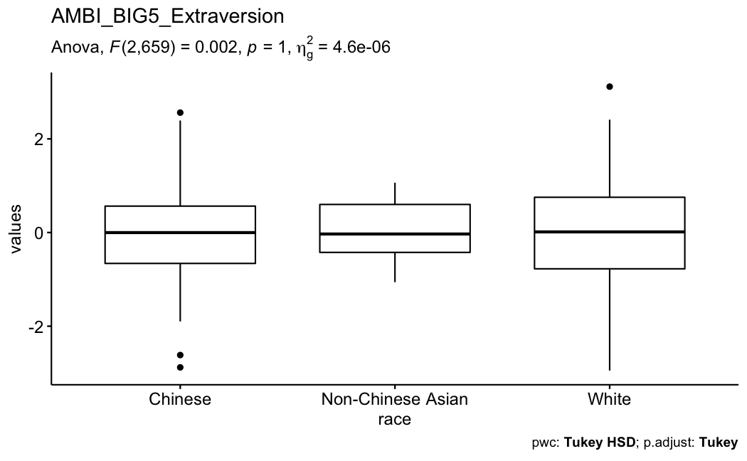
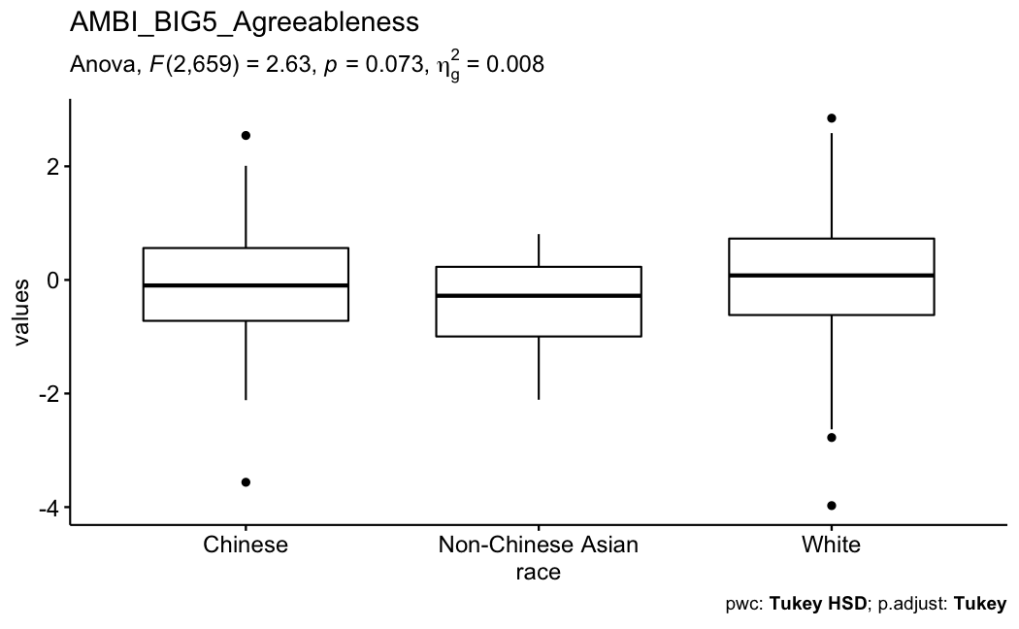
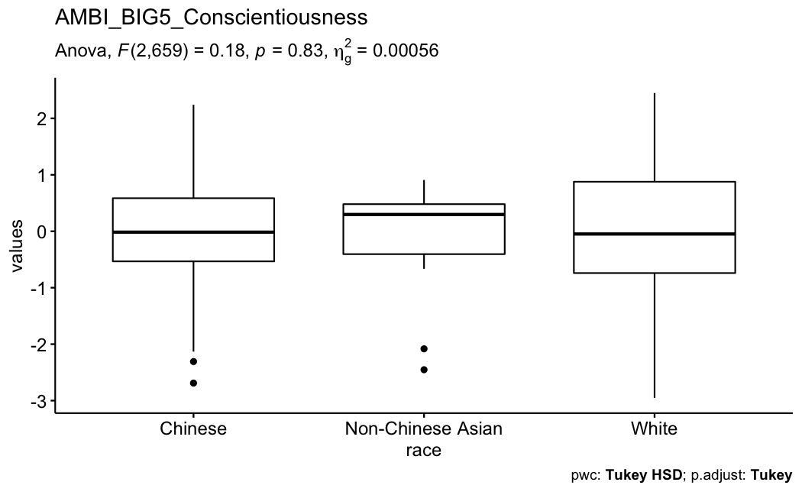
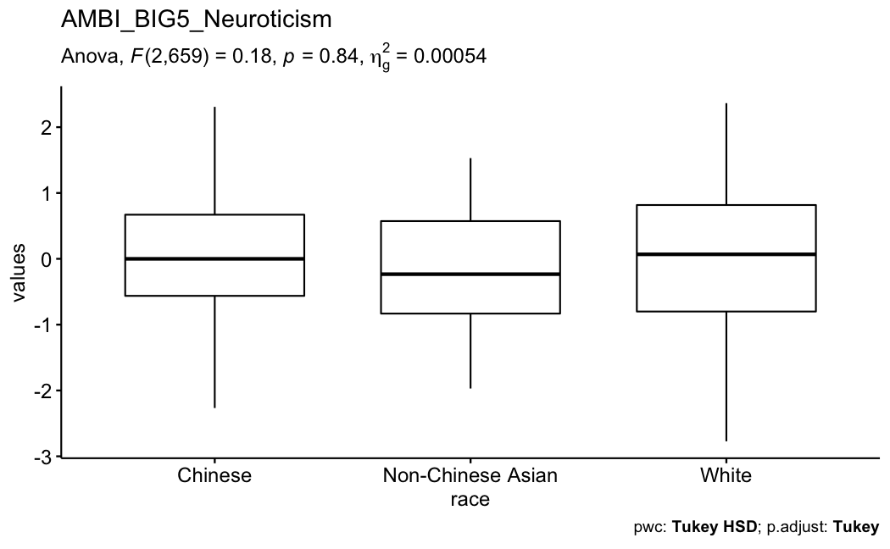
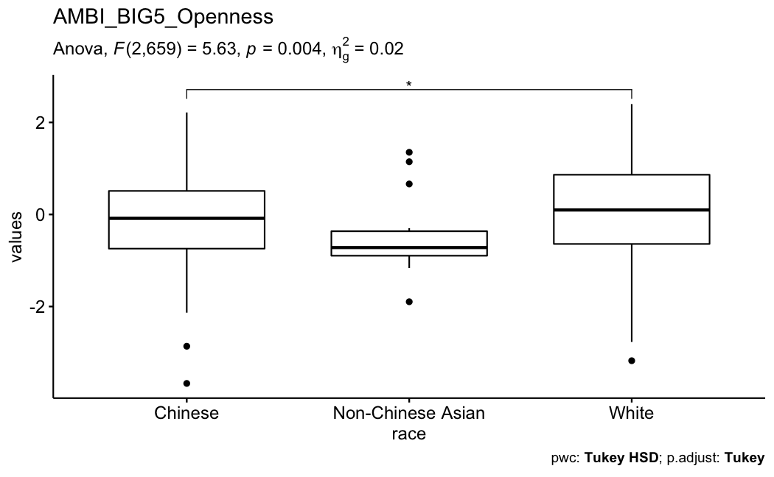
Personality-level Individual Differences – The Big 5

Slide 30
Medical Skepticism
CM23
Xenophobia
Origin
CM6
CM24
CM25
CM10
CM7
CM8
CM26
CM11
CM12
CM9
Attitudes
CM13
26-items
CM1
Demographics
COVID-19 Screener
BAI (Anxiety)
BDI (Depression)
COVID Misconceptions
CM2
CM3
CM4
CM5
Politics
AntiVax
CM14
CM15
CM20
CM21
Media
CM16
CM17
CM18
CM22
CM19
Notes:
Hierarchical Bayesian belief network
Top-Down: Abstract -> Concrete Tiers
Abstract beliefs serve as generative models for more concrete ones
Worldview -> theories -> claims -> intentions
Consider the outcome of interest (Judgments)
Bottom-Up: Structure Learning
Bayesian-directed Hill-Climbing (BDHC)
Plot the log-likelihood loss and number of edges as performance indicators comparing competitive algorithms (eg., HC, MMHC) predicting out of sample data across 10 run 10-fold cross-validation
Use the adjacency matrix to produce a Gaussian linear directed acyclic graph (DAG) to represent a belief network.

Slide 31
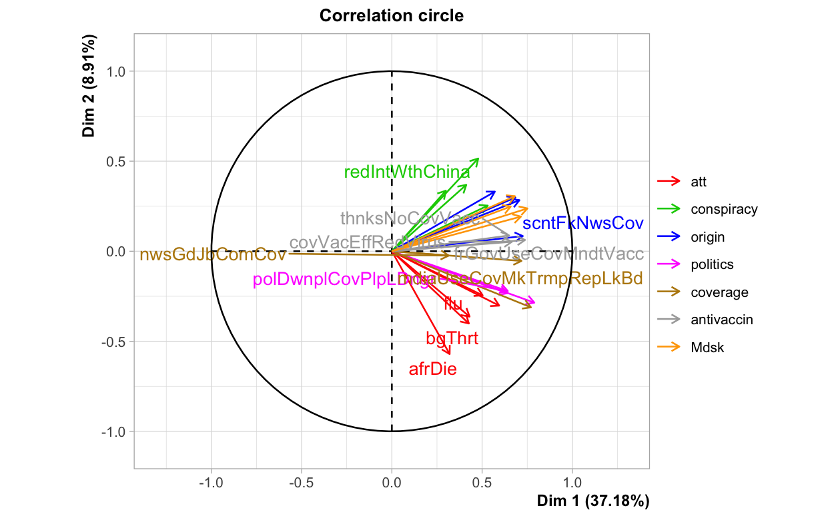
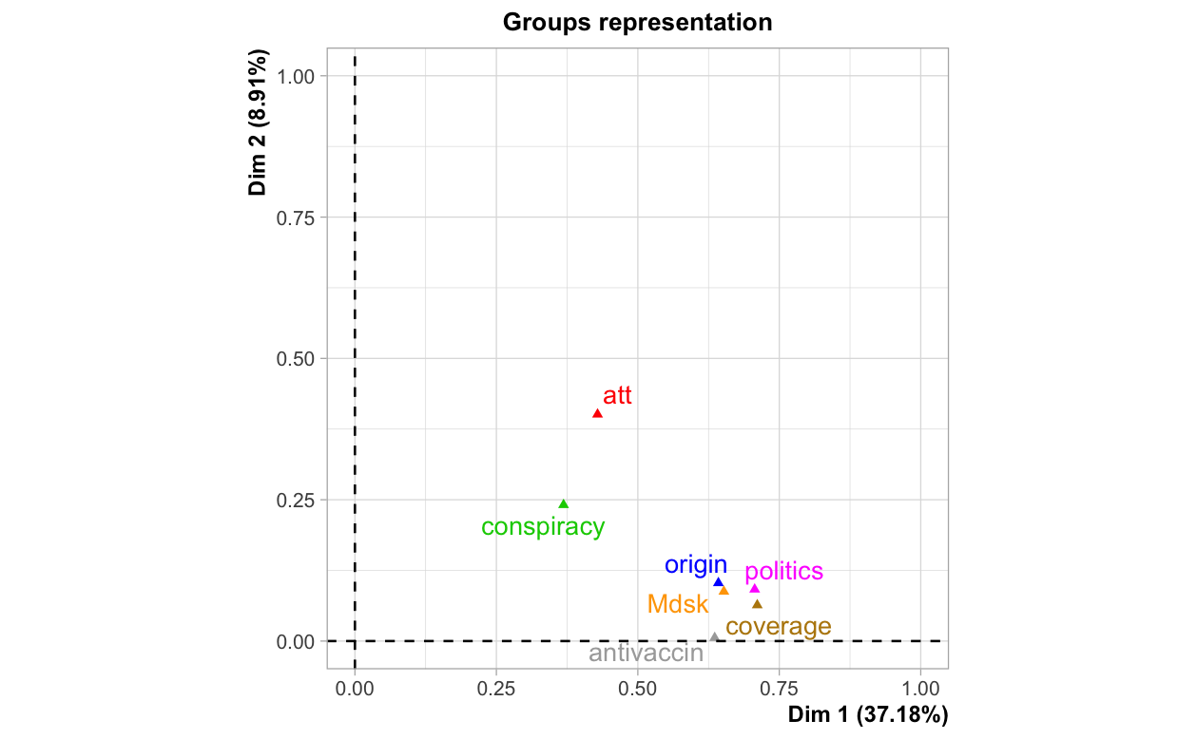
COVID Skepticism Xenophobia, Medical Skepticism, Origin, Attitudes, Politics, Media, AntiVax
Linear?

Slide 32
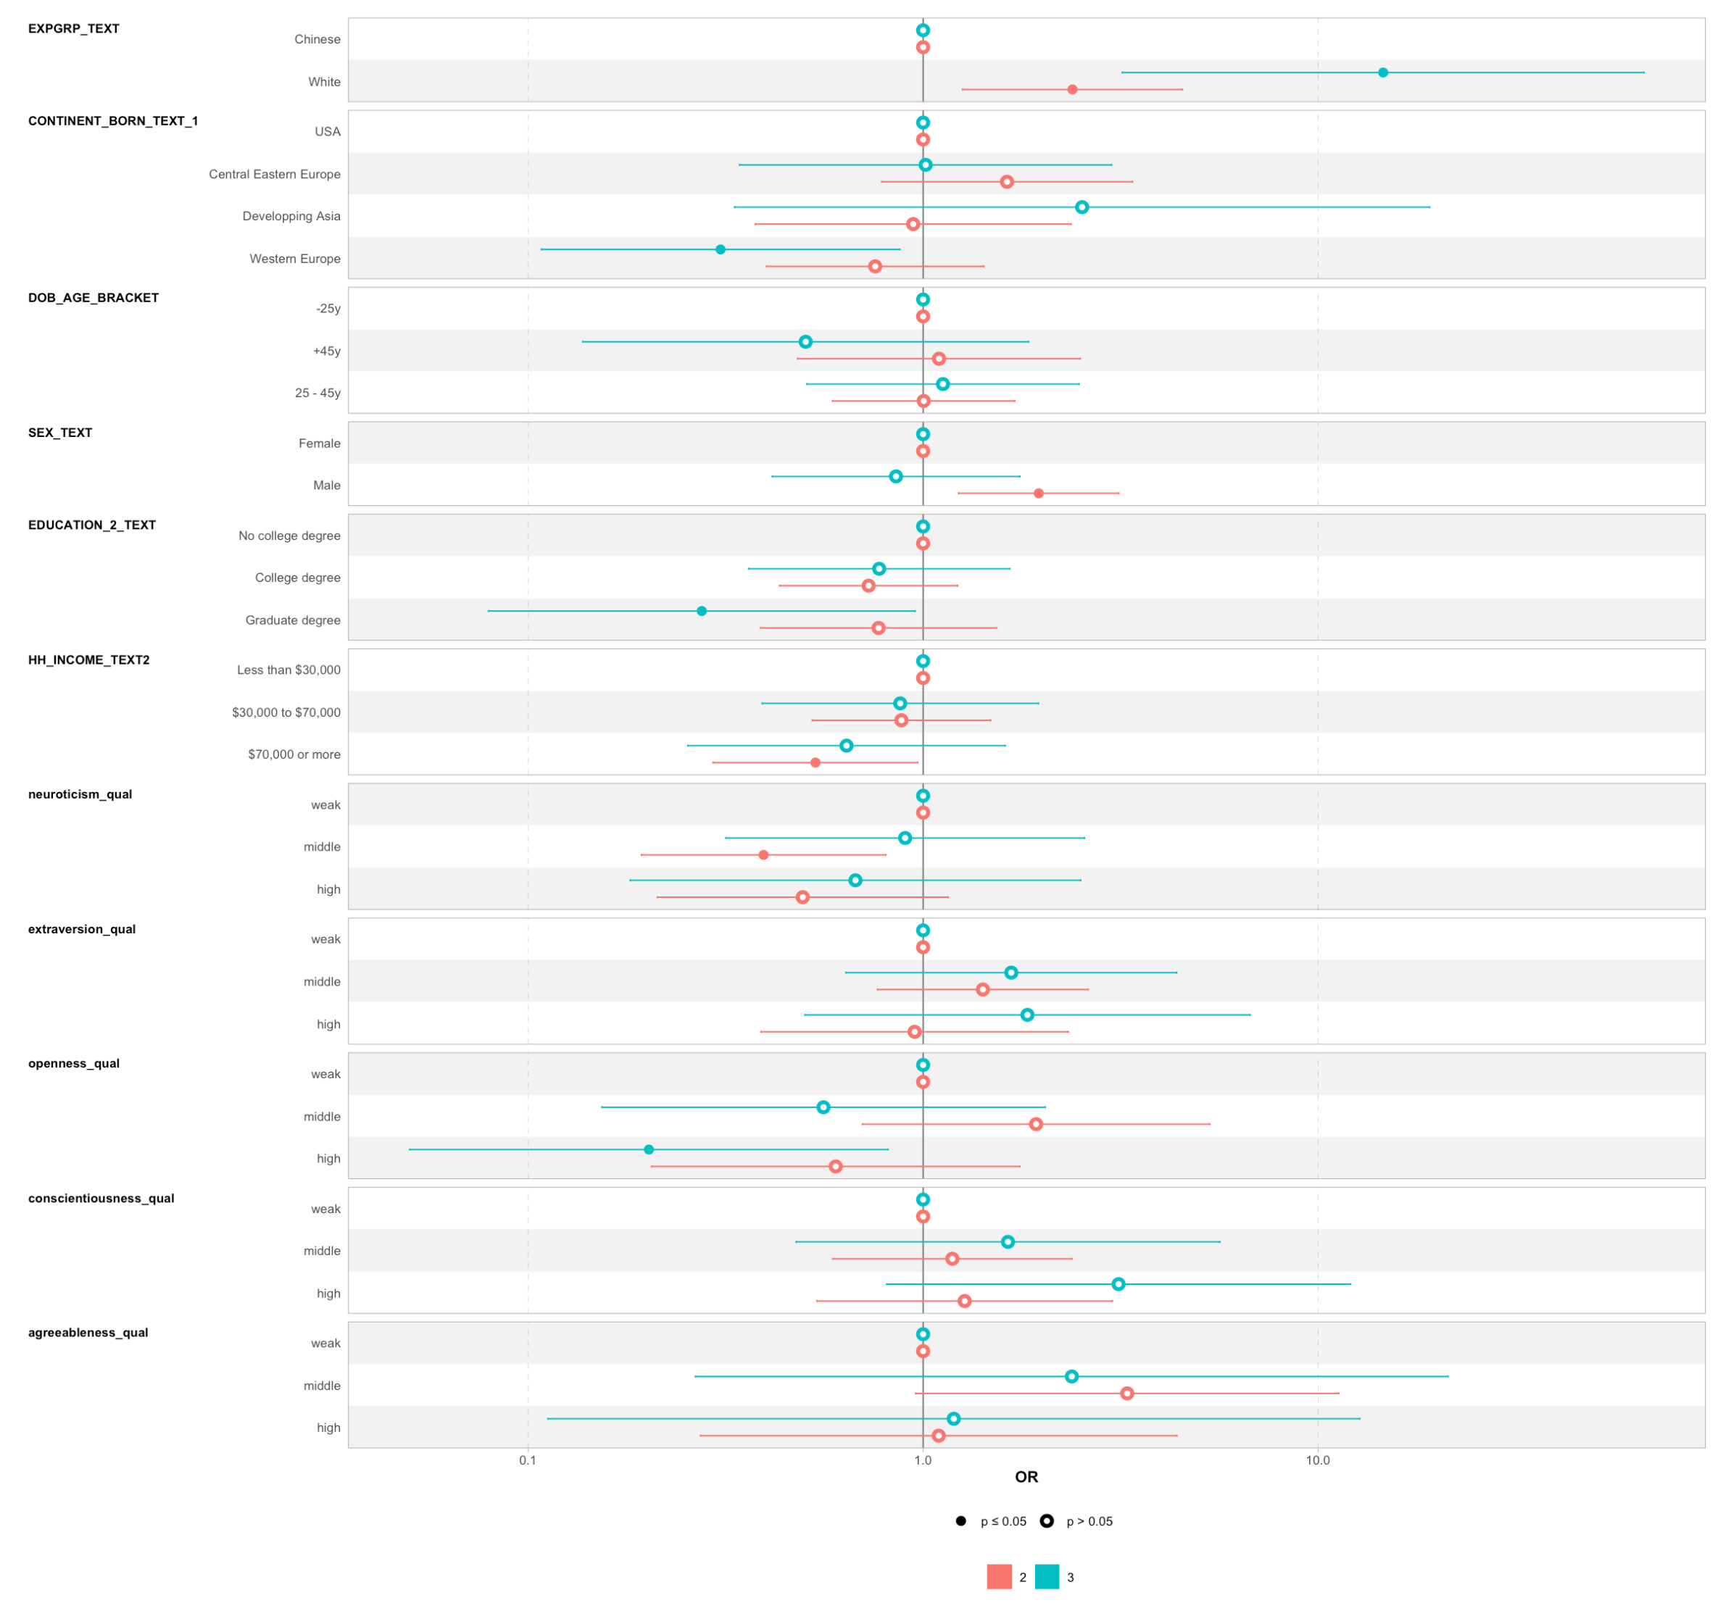
COVID Skepticism Xenophobia, Medical Skepticism, Origin, Attitudes, Politics, Media, AntiVax
Linear?

Slide 33
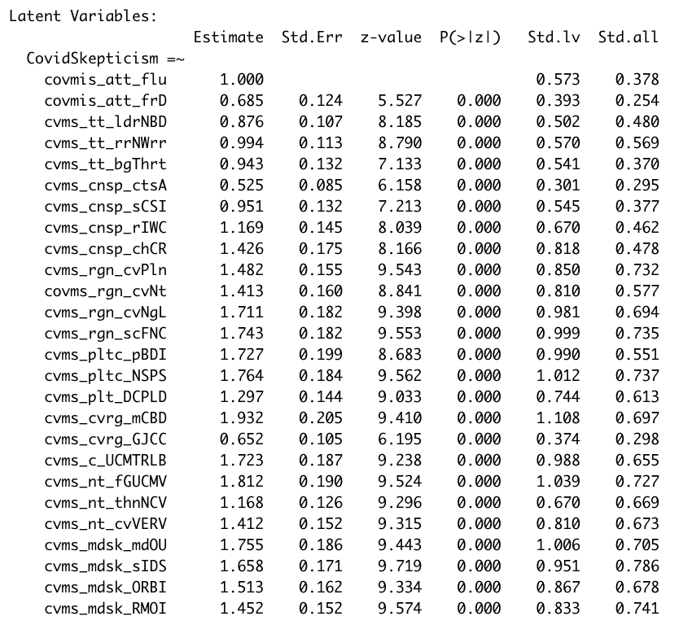
COVID Skepticism Xenophobia, Medical Skepticism, Origin, Attitudes, Politics, Media, AntiVax

Slide 34
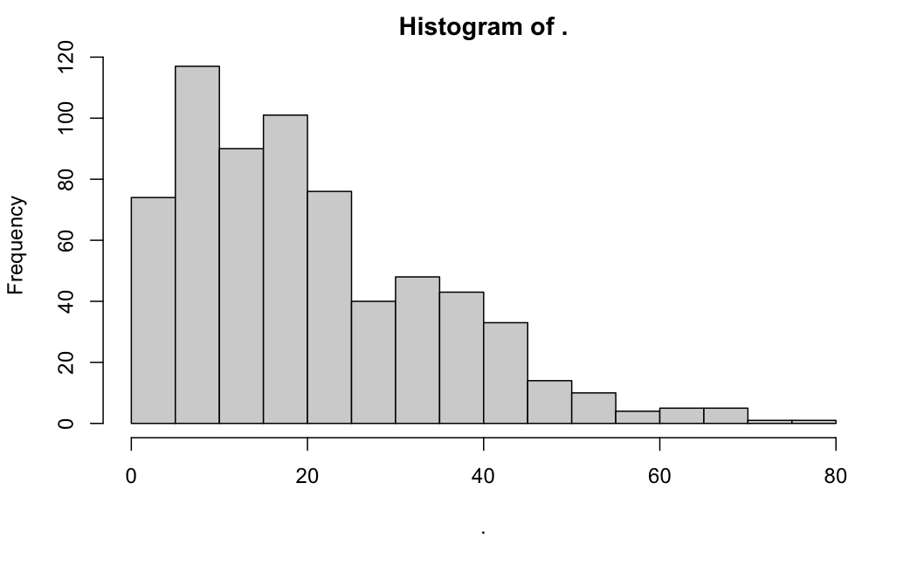
COVID Skepticism Xenophobia, Medical Skepticism, Origin, Attitudes, Politics, Media, AntiVax

Slide 35
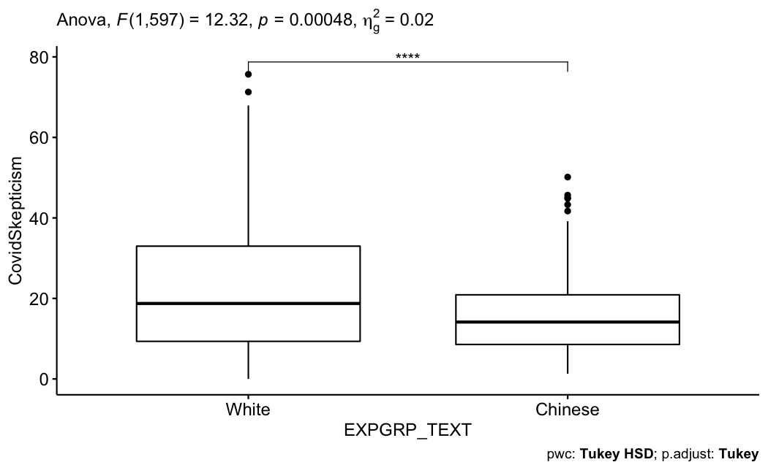
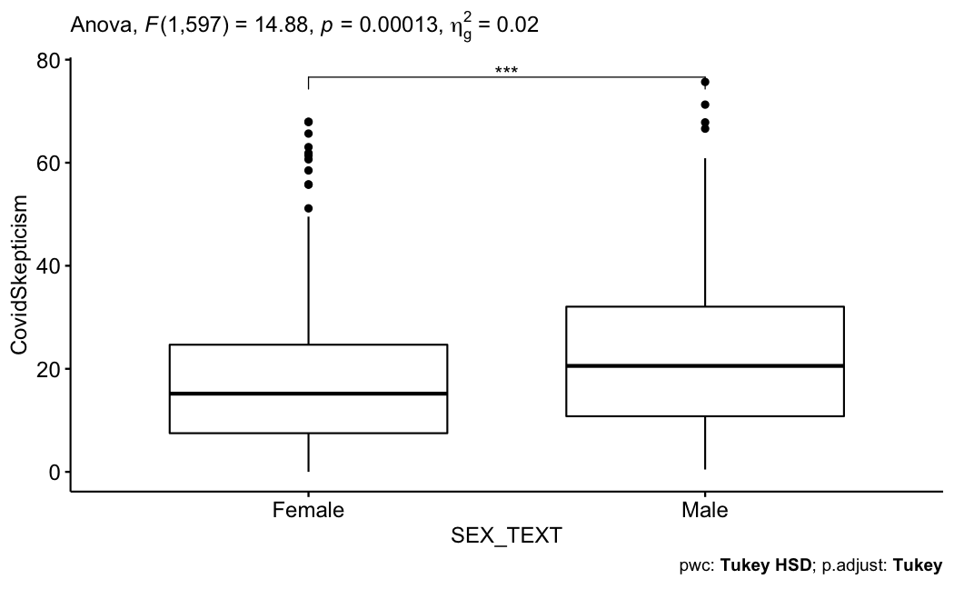
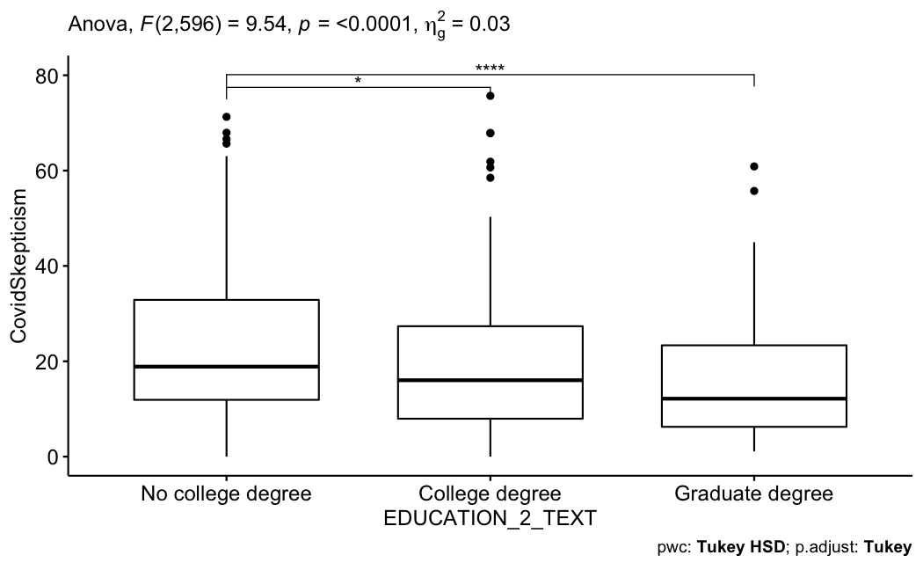
COVID Skepticism Xenophobia, Medical Skepticism, Origin, Attitudes, Politics, Media, AntiVax

Slide 36
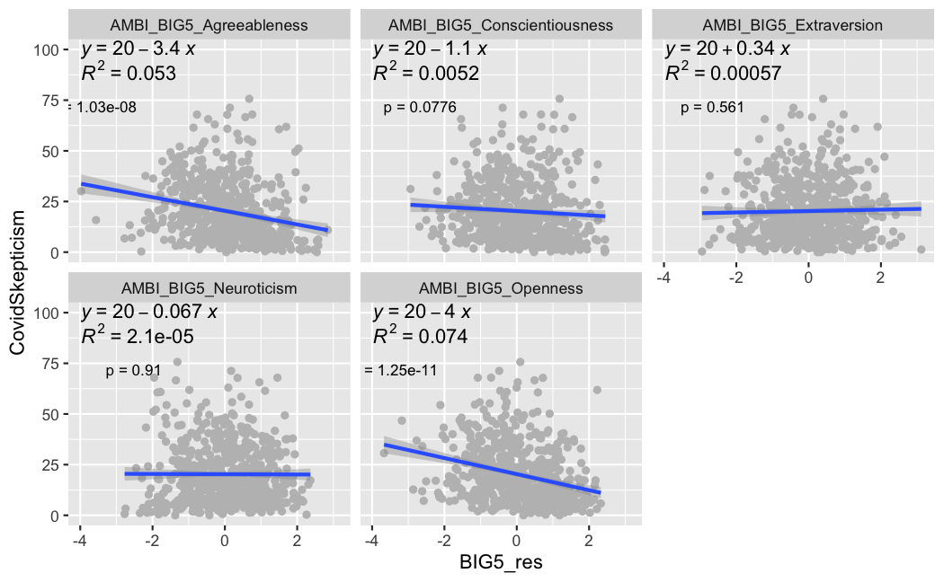
COVID Skepticism Xenophobia, Medical Skepticism, Origin, Attitudes, Politics, Media, AntiVax

Slide 37
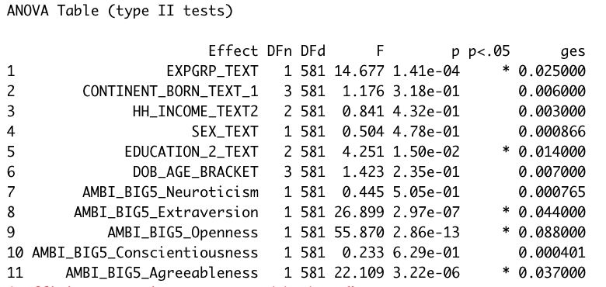
COVID Skepticism Xenophobia, Medical Skepticism, Origin, Attitudes, Politics, Media, AntiVax

Slide 38
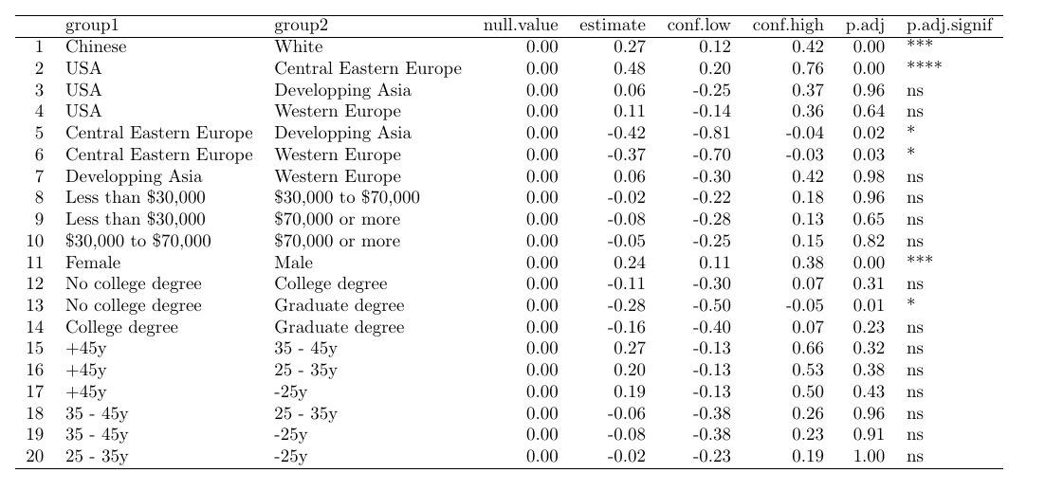
COVID Skepticism Xenophobia, Medical Skepticism, Origin, Attitudes, Politics, Media, AntiVax

Slide 39
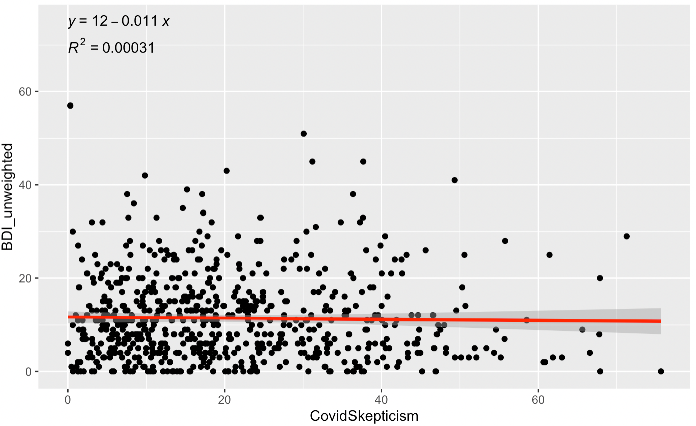
Beck Depression Inventory (BDI)
BDI vs Covid Skepticism
p > 0.05

Slide 41
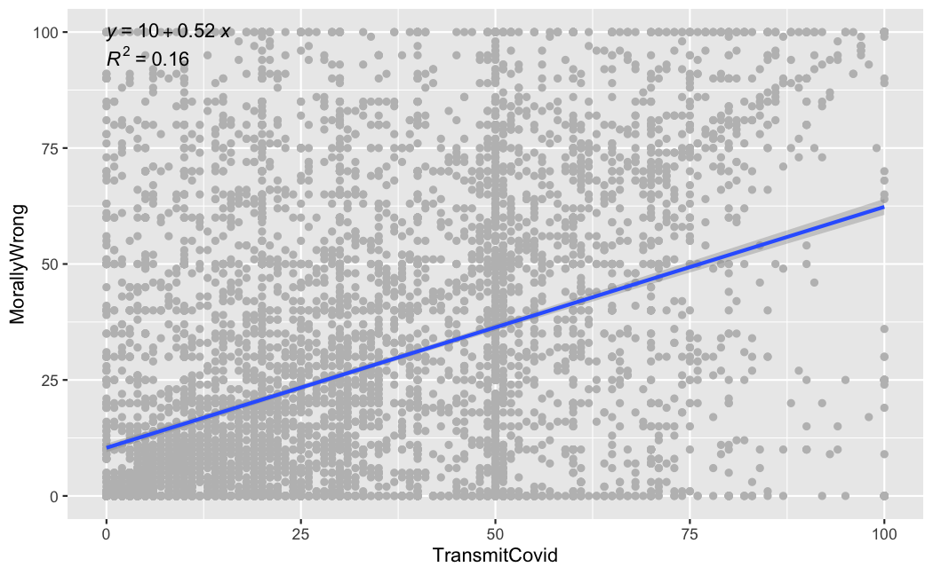
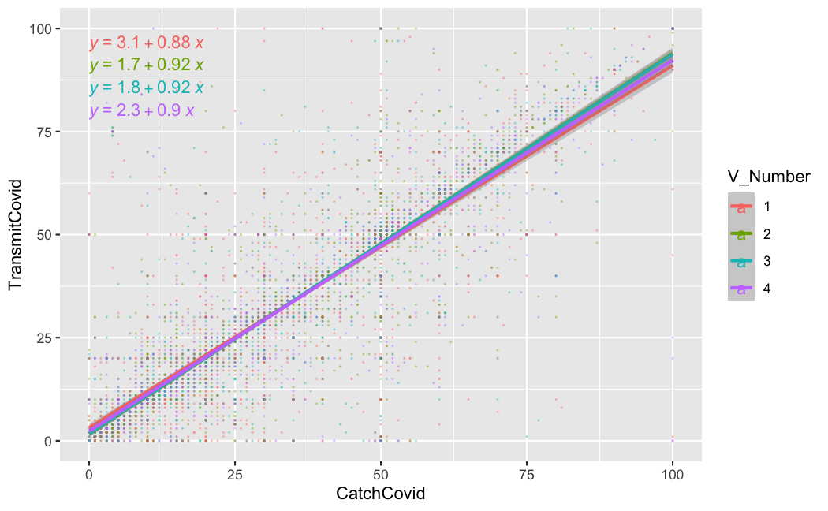
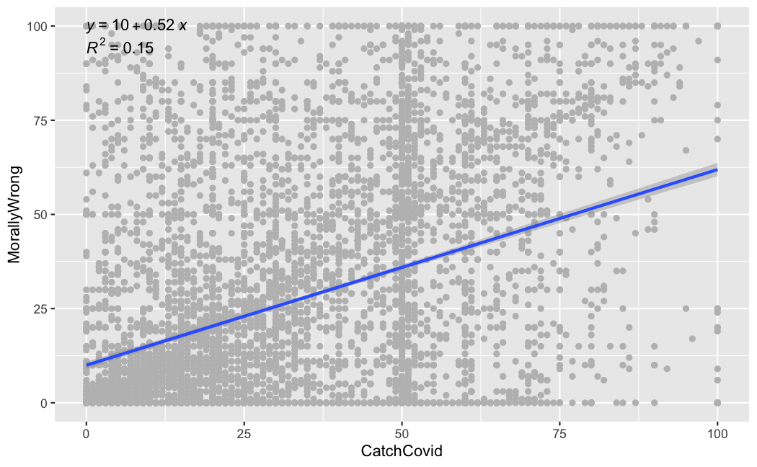
Morality and Covid

Slide 42
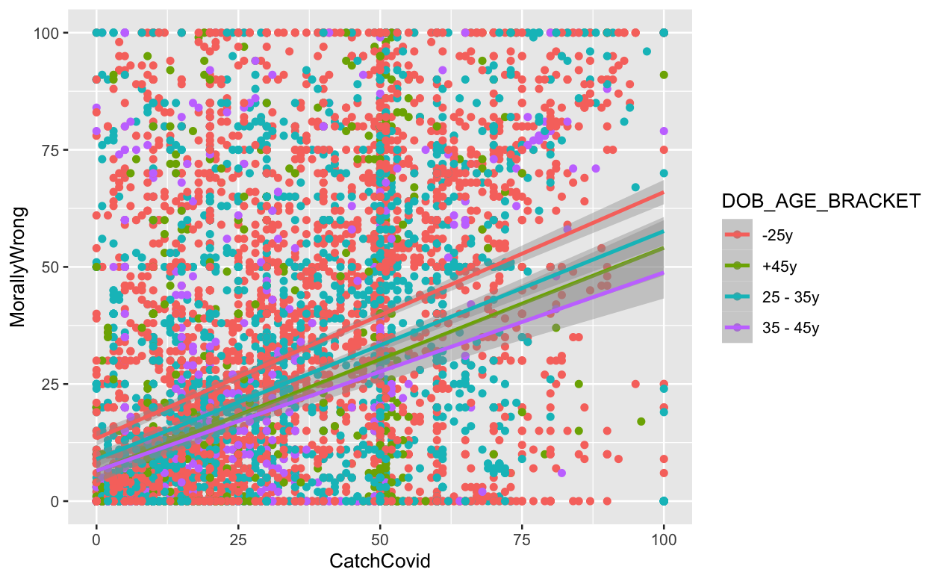
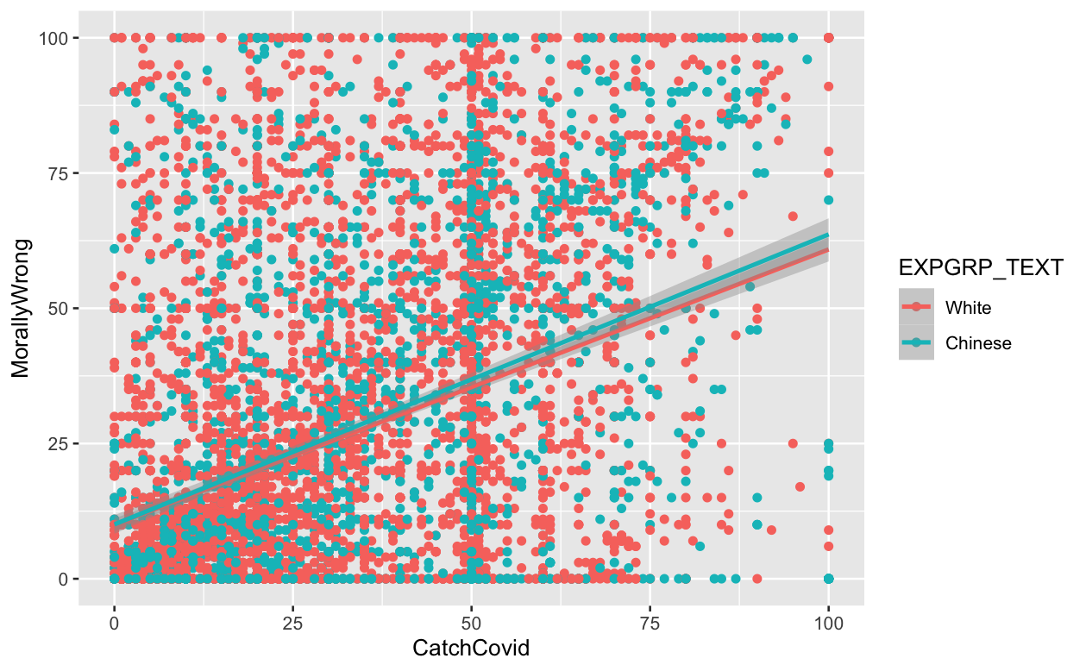
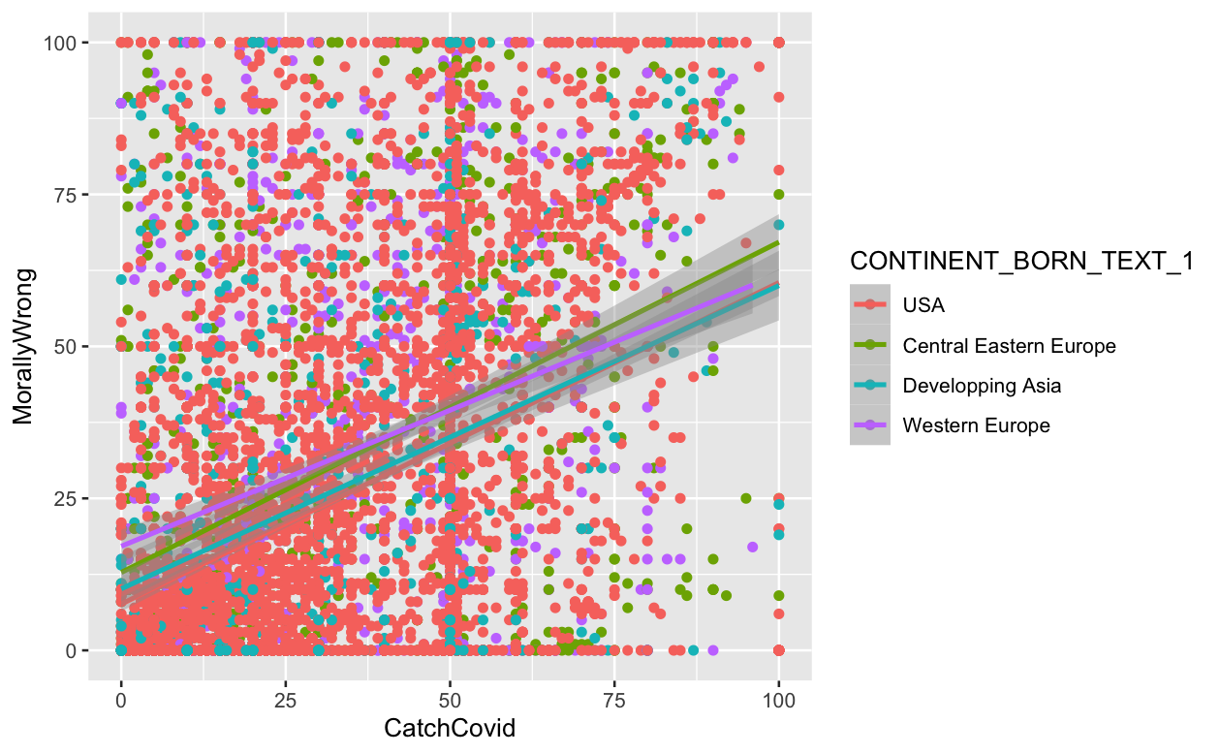
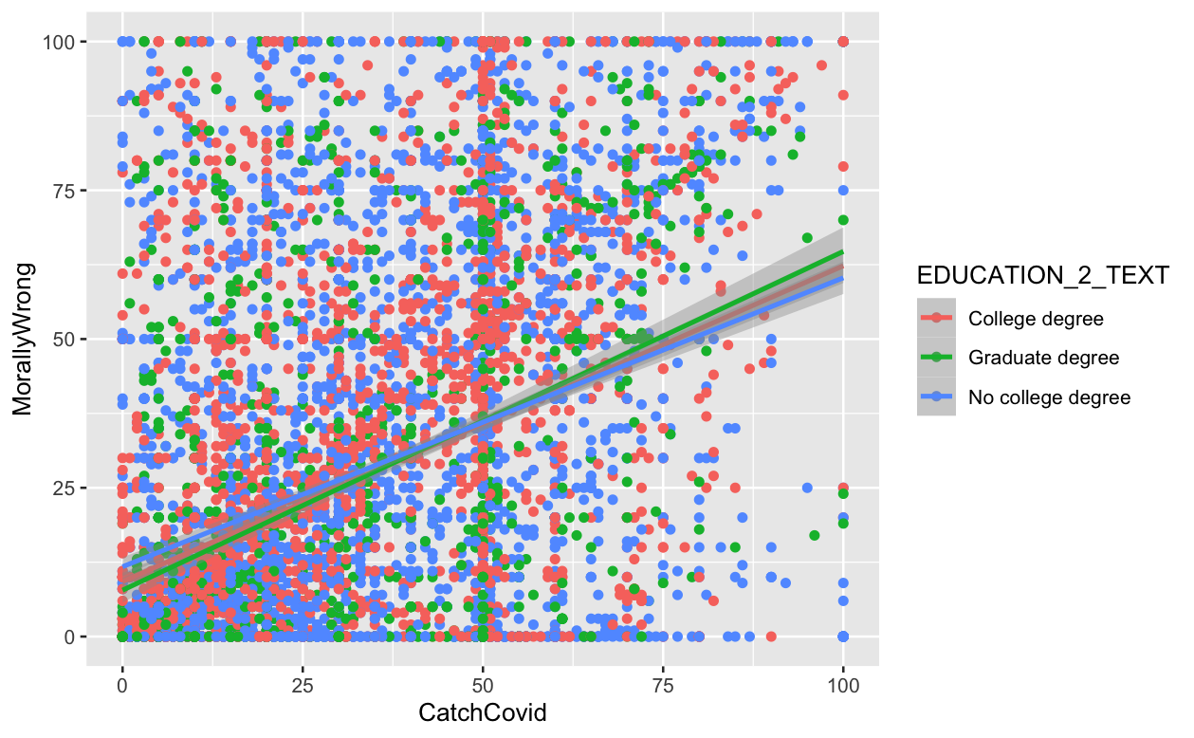
Morality and Covid

Slide 43
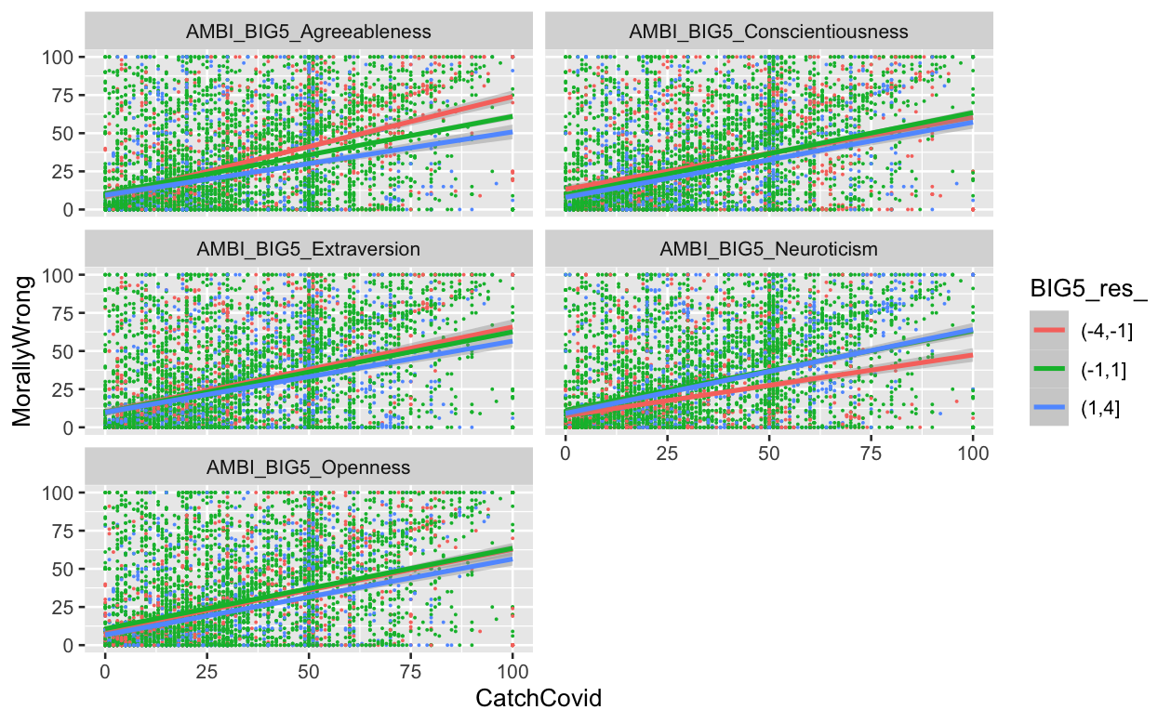
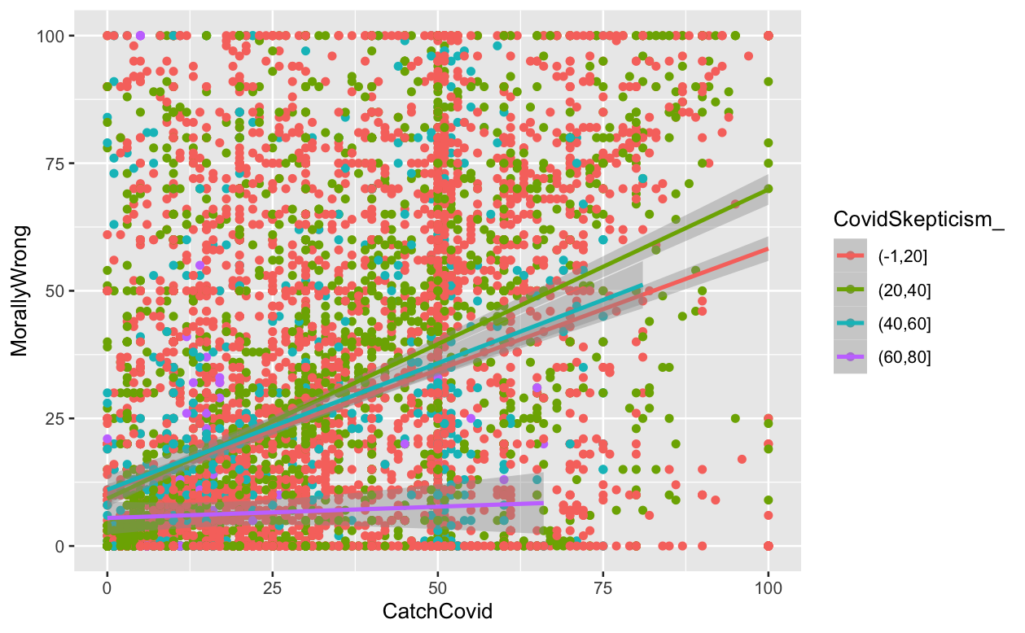
Morality and Covid

Slide 44
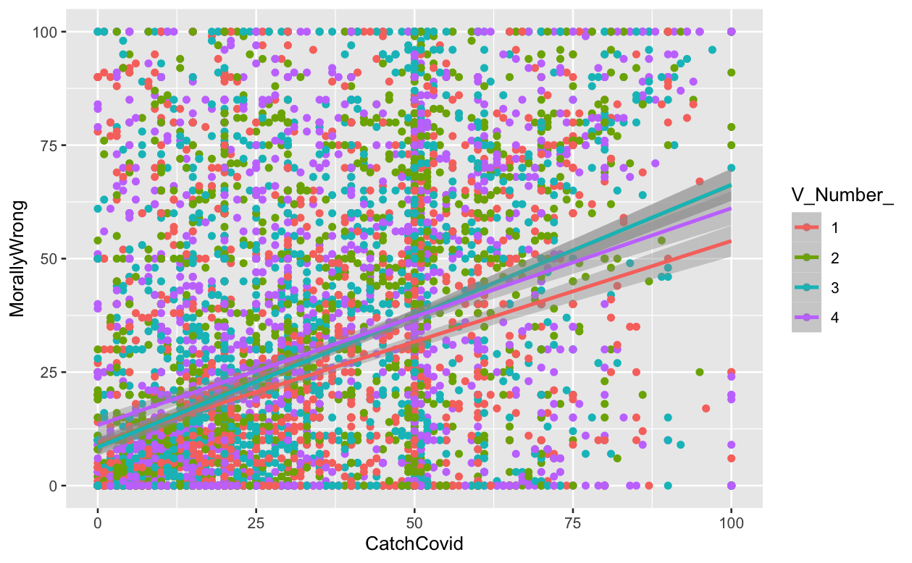
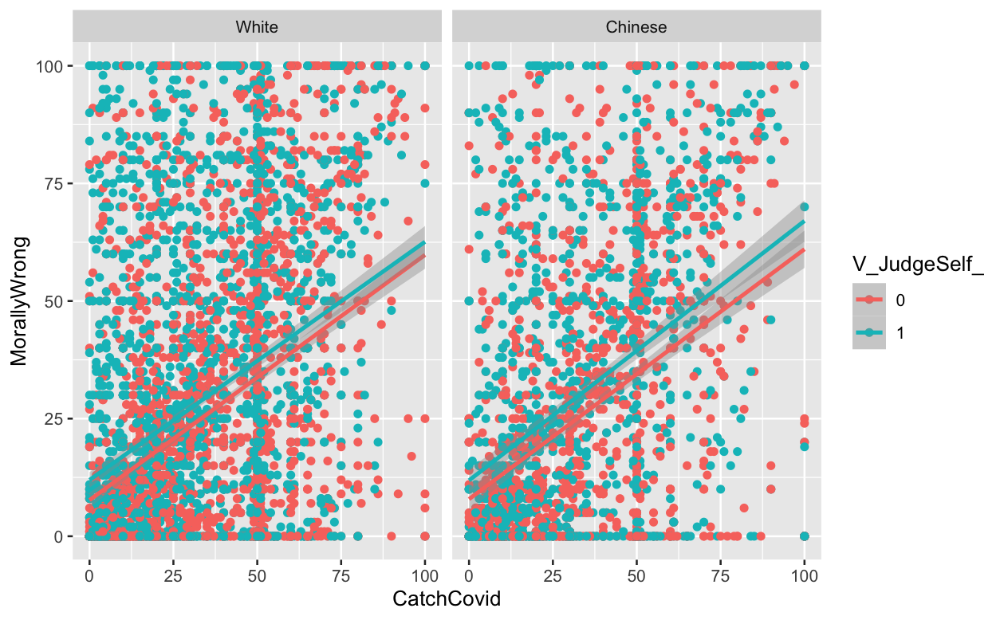


Morality and Covid

Slide 45


Morality and Covid

Slide 46

Morality and Covid

Slide 48



Mixed Models

Slide 49

Mixed Models

Slide 50

Mixed Models

Slide 51


Morality and Covid

Slide 52
Automatous Responding: Learning:
Individual Difference Variables:
Average State Social-Vigilance
State Social-Vigilance Variability

Slide 53
Hypotheses
H1a. Can observed situational cues such as the hoarding of certain objects or the perceived race of a person produce a "devil effect", negatively influencing moral judgments and subsequently “spilling over” into the socially-divisive judgments about other people's potential to contract and transmit COVID-19?
H1b. Are morality judgments about the self stable (i.e., invariant across situations) by contrast?
H2a. Do reported patterns of judgments reflect something akin to a fundamental attribution error, whereby individuals rate themselves as more moral (self-targeted moral-favoritism) and others as less moral (other-targeted moral-denigration), and therefore less prone to contracting and transmitting COVID-19 than others?
H2b. Is self-targeted moral-favoritism or other-targeted moral-denigration more responsible for increases in judgments about other people's potential to contract and transmit COVID-19?
H2c. Does self-targeted moral-favoritism drive other-targeted moral-denigration?
H3a. Does people reduce their attributions of COVID-19 contraction and transmission probability after learning prosocial information about a person by mitigating other-targeted moral denigration?
H3b. Does self-targeted moral-favoritism maintain other-targeted moral-denigration and reduce learning effects due to prosocial information?
H4. In the context of COVID-19, are there differences in cue-based situational judgments about others and the self between Chinese and Whites, especially when the target is perceived to be Chinese compared to if they are perceived to be White, Black/African American, or Indian/Sri-Lankan?

Slide 54
Hypotheses
H1a. Can observed situational cues such as the hoarding of certain objects or the perceived race of a person produce a "devil effect", negatively influencing moral judgments and subsequently “spilling over” into the socially-divisive judgments about other people's potential to contract and transmit COVID-19?
H1a. Multilevel (level 2 vignette-level observations nested within level 1 participant), multivariate path analysis regressing Other-Targeted COVID-19 Contraction Probability and Other-Targeted COVID-19 Transmission Probability (while correlated with one another) onto the interaction between Race-cue (dummy-coded with American-Name as the reference) x Hoarding-Cue (dummy-coded with Baby Formula as the reference) and their main-effects, as well as the main effects of Age, Location, and Store-Type, mediated by Other-Targeted Moral Judgments.
Model may be rerun pruning non-significant effects of Age, Location, Store-Type, and the correlation between Other-Targeted COVID-19 Contraction Probability and Other-Targeted COVID-19 Transmission Probability. Model may be further rerun compressing Hoarding-cue into 2-levels (Morally-Condonable (ref.) vs. Morally-Questionable).

Slide 55
Hypotheses
H1b. Are morality judgments about the self stable (i.e., invariant across situations) by contrast?
Multilevel (level 2 vignette-level observations nested within level 1 participant) path analysis regressing Self-Targeted Moral Judgments onto the interaction between Race-cue (dummy-coded with American-Name as the reference) x Hoarding-cue (dummy-coded with Baby Formula as the reference) and their main-effects, as well as the main effects of Age, Location, and Store-Type
Model may be rerun pruning non-significant effects of Age, Location, Store-Type, and the correlation between Other-Targeted COVID-19 Contraction Probability and Other-Targeted COVID-19 Transmission Probability. Model may be further rerun compressing Hoarding-cue into 2-levels (Morally-Condonable (ref.) vs. Morally-Questionable).

Slide 56
Hypotheses
H2a. Do reported patterns of judgments reflect something akin to a fundamental attribution error, whereby individuals rate themselves as more moral (self-targeted moral-favoritism) and others as less moral (other-targeted moral-denigration), and therefore less prone to contracting and transmitting COVID-19 than others?
Multilevel (level 2 vignette-level observations nested within level 1 participant) multivariate path analysis regressing Self-Targeted COVID-19 Contraction Probability and Self-Targeted COVID-19 Transmission Probability (while correlated with one another) regressed onto the Difference between Other-targeted and Self-targeted Morality Judgments and its interaction with Race-cue and Hoarding-cue, while covarying the main effects of Race, Hoarding, Age, Location, and Store-Type.
Model may be rerun pruning non-significant effects of Age, Location, Store-Type, and the correlation between Self-Targeted COVID-19 Contraction Probability and Self-Targeted COVID-19 Transmission Probability. Model may be further rerun compressing Hoarding-cue into 2-levels (Morally-Condonable (ref.) vs. Morally-Questionable).

Slide 57
Hypotheses
H2b. Is self-targeted moral-favoritism or other-targeted moral-denigration more responsible for increases in judgments about other people's potential to contract and transmit COVID-19?
Multilevel (level 2 vignette-level observations nested within level 1 participant) multivariate path model whereby Other-Targeted COVID-19 Contraction Probability and Other-Targeted COVID-19 Transmission Probability are regressed onto Self-Targeted Morality, Other-Targeted Morality (their correlation), and their respective interactions with Race-cue and Hoarding-cue while covarying the main effects of Race, Hoarding, Age, Location, and Store-Type.
Model may be rerun pruning non-significant effects of Age, Location, Store-Type, the correlation between Other-Targeted COVID-19 Contraction Probability and Other-Targeted COVID-19 Transmission Probability, and the the correlation between Self-Targeted Morality and Other-Targeted Morality. Model may be further rerun compressing Hoarding-cue into 2-levels (Morally-Condonable (ref.) vs. Morally-Questionable).

Slide 58
Hypotheses
H2c. Does self-targeted moral-favoritism drive other-targeted moral-denigration?
Multilevel (level 2 vignette-level observations nested within level 1 participant) multivariate path model of Other-Targeted Morality regressed onto Self-Targeted Morality and its interaction with Race x Hoarding cues while covarying the main effects of Race, Hoarding, Age, Location, and Store-Type.
Model may be rerun pruning non-significant effects of Age, Location, and Store-Type. Model may be further rerun compressing Hoarding-cue into 2-levels (Morally-Condonable (ref.) vs. Morally-Questionable).

Slide 59
Hypotheses
H3a. Does people reduce their attributions of COVID-19 contraction and transmission probability after learning prosocial information about a person by mitigating other-targeted moral denigration?
Multilevel (level 2 vignette-level observations nested within level 1 participant) multivariate path model of Other-Targeted COVID-19 Contraction Probability from Pre-post Learning and Other-Targeted COVID-19 Transmission Probability from Pre-post Learning regressed onto the interaction between Appeal-type (Prosocial(ref.) vs. Defensive), Race-cues and Hoarding cues (and their lower-order main effects) while covarying the main effects of Age, Location, Store-Type, and Framing, mediated by Other-Targeted Morality from Pre-Post Learning.
Model may be rerun pruning non-significant effects of Age, Location, Store-Type, and Framing. Model may be further rerun compressing Hoarding-cue into 2-levels (Morally-Condonable (ref.) vs. Morally-Questionable).

Slide 60
Hypotheses
H3b. Does self-targeted moral-favoritism maintain other-targeted moral-denigration and reduce learning effects due to prosocial information?
H3a model re-run with Self-Targeted Morality interacting with Appeal-type (Prosocial(ref.) vs. Defensive), Race-cues and Hoarding cues.

Slide 61
Hypotheses
H4. In the context of COVID-19, are there differences in cue-based situational judgments about others and the self between Chinese and Whites, especially when the target is perceived to be Chinese compared to if they are perceived to be White, Black/African American, or Indian/Sri-Lankan?
Moderation by Racial/Ethnic group will be tested via tests of group invariance/group equivalence for the models above. Models will be rerun merging US-Whites with Non-US Whites if they are found to be invariant.

Slide 62
Devil-Effect Analysis Steps
Aggregate
Group Analyses

Slide 63
GDPR Compliance
Prolific is GDPR compliant https://researcher-help.prolific.co/hc/en-gb/articles/360009094594-Data-Protection-and-Privacy
You cannot ask participants for:
First and/or Last Name
Address
Date of Birth
Phone Number
9 digit ZIP code or full UK postcode
However, you can ask for a 5 digit ZIP code or the first half of a UK postcode
Links to social media accounts or posts.
These may contain participant information or images eg. Twitter/Facebook/Instagram
Email Address
However, you can ask for participants' Prolific email which will look like '594a5d31833f6d0001623f8a@email.prolific.co' and can be used like a regular email to run multi part studies that require you to contact participants

Slide 64
Personality-level Individual Differences MAIA-32, Life Optimism, BIS/BAS, Ego Resilience, ERQ
In Aggregate
By group

Slide 65
Psychopathology-level Individual Differences PDI, BDI, BAI
In Aggregate
By group

Slide 66







Numerosity
Location
Motion
Color
Size
Phase 2 Conceptual Prime
Notes:
Traits that are not self-reportable: Socially-influenced Perceptual Biases (Phase 2) and Cognitive Effort (Phase 3)
MAIA-32 (Interoceptive Awareness) (Attention allocation to the self)
Life Optimism Test (Trait Optimism)
BIS/BAS
Inhibition
Drive
Fun Seeking
Reward Responsiveness
Ego Resilience (Trait Resilience)
Emotion Regulation Questionnaire
Trait Reappraisal ->
Trait Suppression ->
Peters Delusions Inventory (Psychoticism)

Slide 67





Numerosity
Location
Motion
Color
Size
Phase 2
Social Prime
Notes:
Traits that are not self-reportable: Socially-influenced Perceptual Biases (Phase 2) and Cognitive Effort (Phase 3)
MAIA-32 (Interoceptive Awareness) (Attention allocation to the self)
Life Optimism Test (Trait Optimism)
BIS/BAS
Inhibition
Drive
Fun Seeking
Reward Responsiveness
Ego Resilience (Trait Resilience)
Emotion Regulation Questionnaire
Trait Reappraisal ->
Trait Suppression ->
Peters Delusions Inventory (Psychoticism)

Slide 68
Perceptual-level Individual Differences Conceptual primes, Social Primes
In Aggregate
By group

Slide 69
Network Analysis Steps
Bayesian Belief Network algorithms (e.g., BDHC, Min-Max, MMHC) as described in Powell, Weisman, and Markman, 2018, splitting the data within each Racial/Ethnic Group 80%/20% and predicting out of sample data across 10 run 10-fold cross validation.
https://machinelearningmastery.com/introduction-to-bayesian-belief-networks/
Bnlearn package in R
https://www.r-bloggers.com/2015/02/bayesian-network-in-r-introduction/
https://mathewanalytics.com/wp-content/uploads/2015/10/bnpresentation-150309083756-conversion-gate011.pdf
https://www.r-bloggers.com/2018/09/bayesian-network-example-with-the-bnlearn-package/
https://gauss.inf.um.es/umur/xjurponencias/talleres/J3.pdf
https://www.bnlearn.com/about/teaching/slides-bnshort.pdf
https://bookdown.org/robertness/causalml/docs/tutorial-probabilistic-modeling-with-bayesian-networks-and-bnlearn.html
BayesianNetwork Shiny application
https://cran.r-project.org/web/packages/BayesianNetwork/vignettes/BayesianNetwork.html
Bnstruct package in R
https://cran.r-project.org/web/packages/bnstruct/vignettes/bnstruct.pdf

Slide 70
Medical Skepticism
CM23
Xenophobia
Origin
CM6
CM24
CM25
CM10
CM7
CM8
CM26
CM11
CM12
CM9
Attitudes
CM13
26-items
CM1
Demographics
COVID-19 Screener
BAI (Anxiety)
BDI (Depression)
COVID Misconceptions
CM2
CM3
CM4
CM5
Politics
AntiVax
CM14
CM15
CM20
CM21
Media
CM16
CM17
CM18
CM22
System Features:
Density: connections
Average path length: efficiency
Transitivity: triadic closure
Clustering: grouping
Degree distribution: hierarchy
Positional Features:
Indegree centrality: ease of generation
Outdegree centrality: influence
Closeness Centrality: speed of generation
Betweenness Centrality: bridge potential
Eigenvector Centrality: belief rigidity/immunity
CM19
Notes:
Hierarchical Bayesian belief network
Top-Down: Abstract -> Concrete Tiers
Abstract beliefs serve as generative models for more concrete ones
Worldview -> theories -> claims -> intentions
Consider the outcome of interest (Judgments)
Bottom-Up: Structure Learning
Bayesian-directed Hill-Climbing (BDHC)
Plot the log-likelihood loss and number of edges as performance indicators comparing competitive algorithms (eg., HC, MMHC) predicting out of sample data across 10 run 10-fold cross-validation
Use the adjacency matrix to produce a Gaussian linear directed acyclic graph (DAG) to represent a belief network.

